Slide 1
Front-end development process
Anna Wang
THE UNIVERSITY OF TEXAS AT AUSTIN
BHP/MIS MAY 2018

Slide 3
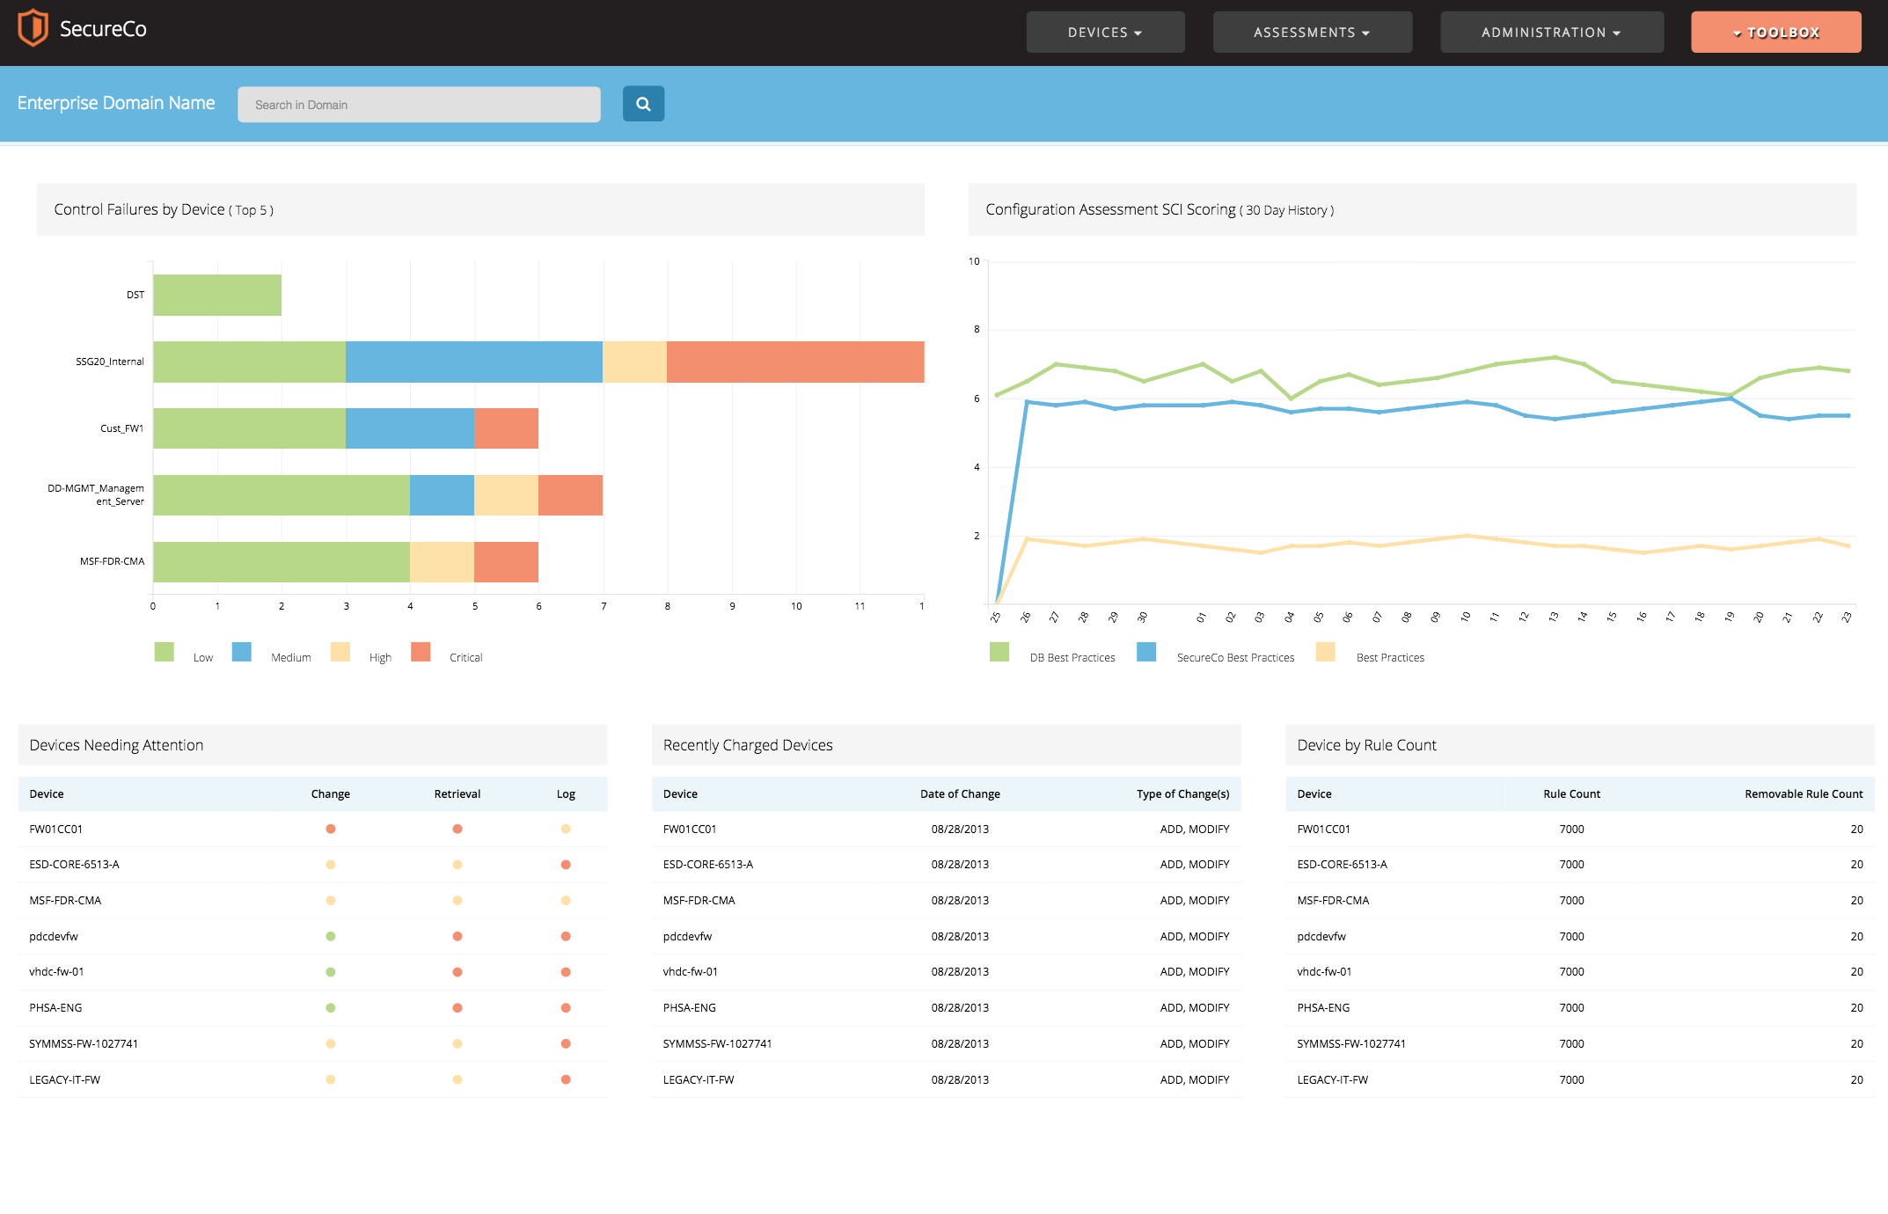

Slide 4
The process
sketch
>>
structure
>>
optimize
>>
build
Notes:
Sketch – What will it look like in mobile? Notice 12 column grid
Structure – How should the html be structured for responsiveness? How can we structure the rest of the files to be modular and support a larger application?
Optimize – Determine frameworks and libraries to use
Build – Start building

Slide 5
The process
sketch
>>
structure
>>
optimize
>>
build
Notes:
Sketch – What will it look like in mobile? Notice 12 column grid
Structure – How should the html be structured for responsiveness? How can we structure the rest of the files to be modular and support a larger application?
Optimize – Determine frameworks and libraries to use
Build – Start building

Slide 6
The process
sketch
>>
structure
>>
optimize
>>
build
Notes:
Sketch – What will it look like in mobile? Notice 12 column grid
Structure – How should the html be structured for responsiveness? How can we structure the rest of the files to be modular and support a larger application?
Optimize – Determine frameworks and libraries to use
Build – Start building

Slide 7
The process
sketch
>>
structure
>>
optimize
>>
build
Notes:
Sketch – What will it look like in mobile? Notice 12 column grid
Structure – How should the html be structured for responsiveness? How can we structure the rest of the files to be modular and support a larger application?
Optimize – Determine frameworks and libraries to use
Build – Start building

Slide 8
Frameworks & libraries
npm (node package manager)
Gulp
Gulp-sass
Normalize
D3
Bourbon-neat
Notes:
Npm (Node Package Manager)
Node modules used: gulp, gulp-sass, normalize, d3, bourbon-neat
Gulp, gulp-sass: workflow managers to compile sass
Normalize: to adjust for different browsers
D3: chart building (used c3 overlay library)
Bourbon-neat: responsive, mobile-first grid
Go into file structure/hierarchy. Also talk about SASS modules/how they fit into each other

Slide 9
Challenges
Notes:
I’ve never coded data visualizations before so it was an interesting challenge but I learned how cool D3 is (and how easy C3 is to use) so that’s definitely something I want to explore more
Had some challenges with ambiguity: wasn’t explicitly shown a mobile mockup, so had to guess about some things that would happen in mobile
Time constraint: only had 2 days to build, had to ‘make-do’ with certain things. I know it isn’t perfect but given more time I could work out some kinks
I suppose there were challenges with multiple screen sizes, but I had that taken care of at the beginning with grids and initial planning
Tested on mulltiple browsers, didn’t use browser-dependent frameworks (like flexbox) but if I did I would have made SASS mixins to make it easier to code for mulitple broweser.

Slide 10
Front-end development process
Anna Wang
THE UNIVERSITY OF TEXAS AT AUSTIN
BHP/MIS MAY 2018

